Slide 1
2.1 | Java Exceptions

Slide 2
Video Notes
Exception Basics
  https://mediaplayer.pearsoncmg.com/assets/secs-vn-JI02-Exceptions
Using Exceptions
  https://mediaplayer.pearsoncmg.com/assets/secs-vn-JI03-More-Exceptions

Slide 3
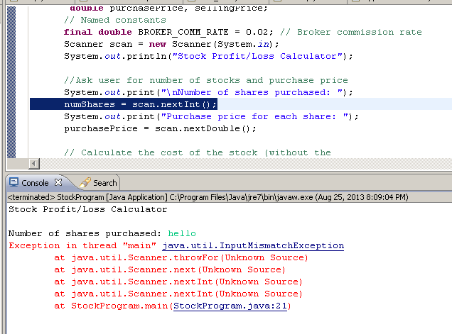
Unhandled Exception
Notes:
Your code will crash if it encounters an unhandled exception (that you did not anticipate)

Slide 4
Exception Handling
If an exception is ignored by the program, the program will terminate abnormally and produce a message
The message includes a call stack trace that:
  indicates the line on which the exception occurred
  shows the method call trail that lead to the attempted execution of the offending line

Slide 5
Java Exception
In Java, an exception (is an object that) describes an unusual or erroneous situation
Java has a predefined set of exceptions and errors that can occur during execution

Slide 6
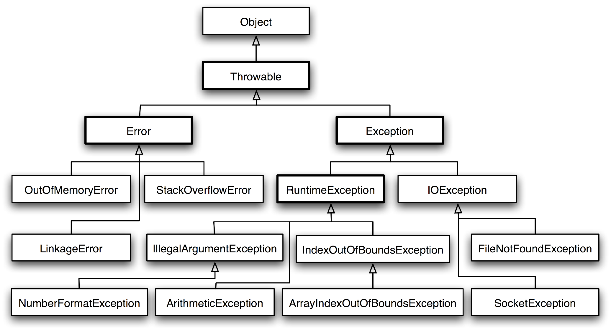
Exception Class Hierarchy (newcircle.com)
Notes:
Errors should not be handled
Runtime exceptions should be avoided (write up to prevent them from happening)
Handle IO and user defined exceptions (checked exceptions)

Slide 7
Checked vs. Unchecked Exceptions
Checked Exceptions
  Compiler checks and you can’t ignore them
  Majority occur when dealing with input and output
    IOException
  Handle them
Unchecked Exceptions
  Extend the class RuntimeException or Error
  Runtime exceptions:
    NumberFormatException
    IllegalArgumentException
    NullPointerException
  Error:
    OutOfMemoryError
  Prevent them from happening

Slide 8
Checked Exceptions
Compiler checks against these exceptions
  FileNotFoundException
  IOException
  NoSuchMethodException
  WriteAbortedException
  ClassNotFoundException

Slide 9
Runtime Exceptions
Raise during runtime
  ArithmeticException
  ArrayIndexOutOfBoundsException
  ClassCastException
  IllegalArgumentException
  IllegalStateException
  IndexOutOfBoundsException
  NoSuchElementException
  NullPointerException
  StringIndexOutOfBoundsException
  UnsupportedOperationException
  https://docs.oracle.com/javase/8/docs/api/java/lang/RuntimeException.html

Slide 10
List of Java Exceptions
List of Java Exceptions
  https://docs.oracle.com/javase/8/docs/api/java/lang/Exception.html
  https://docs.oracle.com/javase/8/docs/api/java/lang/package-tree.html
  https://programming.guide/java/list-of-java-exceptions.html
  https://www.codejava.net/java-core/exception/java-checked-and-unchecked-exceptions

Slide 11
2.2 | Handling Exceptions

Slide 12
Exception Handling
A program can deal with a checked exception in one of three ways:
  handle it where it occurs
  handle it an another place in the program
  ignore it
Compiler will issue a syntax error if a checked exception is not caught or asserted in a throws clause
  Used primarily when programming with files and streams
The manner in which an exception is processed is an important design consideration

Slide 13
How to Handle Exceptions
  Throwing Exceptions
  Catching Exceptions
  finally Clause
  User Defined Exceptions
  References
    https://www.protechtraining.com/bookshelf/java_fundamentals_tutorial/exceptions
    https://www.protechtraining.com/bookshelf/java_fundamentals_tutorial/table_of_contents
Notes:
I am teaching two 203 sections this semester. Students are welcome to participate in another session. Bring laptop.

Slide 14
Throws Clause
    public void read(String filename) throws FileNotFoundException
    {
    FileReader reader = new FileReader(filename);
    Scanner in = new Scanner(reader);
    ...
    }
    public void read(String filename)throws IOException, ClassNotFoundException
    {
    }
Notes:
Throws is used to indicate?

Slide 15
Catching Exceptions
try
{
String filename = ...;
FileReader reader = new FileReader(filename);
Scanner in = new Scanner(reader);
String input = in.next();
int value = Integer.parseInt(input);
...
}
catch (IOException exception)
{
exception.printStackTrace();
}
catch (NumberFormatException exception)
{
System.out.println("Input was not a number");
}

Slide 16
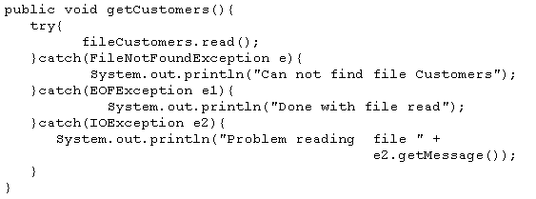
Catching Exceptions
The order of the catch statements can be important if the exceptions being caught belong to the same inheritance branch.

Slide 17
The try Statement
To handle an exception in a program, the line that throws the exception is executed within a try block
A try block is followed by one or more catch clauses
Each catch clause has an associated exception type and is called an exception handler
When an exception occurs, processing continues at the first catch clause that matches the exception type

Slide 18
The finally Clause
Exception terminates current method
Example:
  reader = new FileReader(filename);
  Scanner in = new Scanner(reader);
  readData(in);
  reader.close(); // May never get here
Must execute reader.close() even if exception happens
Use finally clause for code that must be executed “no matter what”

Slide 19
The finally Clause
FileReader reader = new FileReader(filename);
try
{
Scanner in = new Scanner(reader);
readData(in);
}
finally
{
reader.close();
// if an exception occurs, finally clause
// is also executed before exception
// is passed to its handler
}

Slide 20
Exception Execution Flow
GUI Driver
Data Manager
Data Element
Bank
Bank Account
Arraylist <BankAccount>
Extracts withdraw amount and account number from user
int withdraw(acct, amt)
{
}
Displays new balance to user
int withdraw(amt)
{
}
Normal execution flow
Notes:
Best case scenario

Slide 21
Exception Execution Flow
GUI Driver
Data Manager
Data Element
Bank
Bank Account
Arraylist <BankAccount>
try {
Extracts withdraw amount and account number from user
int withdraw(acct, amt) throws IFE
{
}
Displays new balance to user
}
catch (IFE)
int withdraw(amt) throws IFE
{
if amt > balance
throw IFE;
}
no catch for IFE
no catch for IFE
This is where is exception is discovered
This is where is exception can be resolved
Notes:
IFE – insufficient fund exception (you are trying to withdraw money that you don’t have)

Slide 22
2.3 | User Defined Exceptions

Slide 23
Example
/** A demonstration of a runtime exception using the class OurMath. */
public class OurMathDriver
{
public static void main(String[] args)
{
System.out.print("The square root of 9 is ");
System.out.println(OurMath.squareRoot(9.0));
System.out.print("The square root of -9 is ");
System.out.println(OurMath.squareRoot(-9.0));
System.out.print("The square root of 16 is ");
System.out.println(OurMath.squareRoot(16.0));
} // end main
} // end OurMathDriver
The square root of 9 is 3.0
The square root of -9 is Exception in thread "main" SquareRootException:
Attempted square root of a negative number.
at OurMath.squareRoot(OurMath.java:14)
at OurMathDriver.main(OurMathDriver.java:12)
Notes:
Calling squareRoot with a negative number (-9) is bad.

Slide 24
User Defined (Custom) Exceptions
Child of Throwable (class)
Extend the Exception or RuntimeException class
How to create a user defined exception (custom exception) in java?
  https://www.tutorialspoint.com/how-to-create-a-user-defined-exception-custom-exception-in-javace

Slide 25
Custom Exception Class
/** A class of runtime exceptions thrown when an attempt
is made to find the square root of a negative number. */
public class SquareRootException extends RuntimeException
{
public SquareRootException()
{
super("Attempted square root of a negative number.");
} // end default constructor
public SquareRootException(String message)
{
super(message);
} // end constructor
} // end SquareRootException
Notes:
A typical exception class includes two constructors
Use this as a template for Project 1

Slide 26
Another Example
public class OurMath
{
/** Computes the square root of a nonnegative real number.
@param value A real value whose square root is desired.
@return The square root of the given value.
@throws SquareRootException if value < 0. */
public static double squareRoot(double value) throws SquareRootException
{
if (value < 0)
throw new SquareRootException();
else
return Math.sqrt(value);
} // end squareRoot
// < Other methods not relevant to this discussion are here. >
} // end OurMath
Notes:
About to create our own (user defined exception) named SquareRootException

Slide 27
Activity | IFE
Implement a (test) driver and attempt to withdraw fund (money) from your bank account
You would not be able to withdraw money that you don’t have!
Modify the BankAccount class such that an IFE (Insufficient Fund Exception) is raised for the above scenario
  IFE | User defined exception

Slide 28
Excellent Resource
Presenting Exceptions to Users
  https://victorrentea.ro/blog/presenting-exceptions-to-users/

